Slide 1
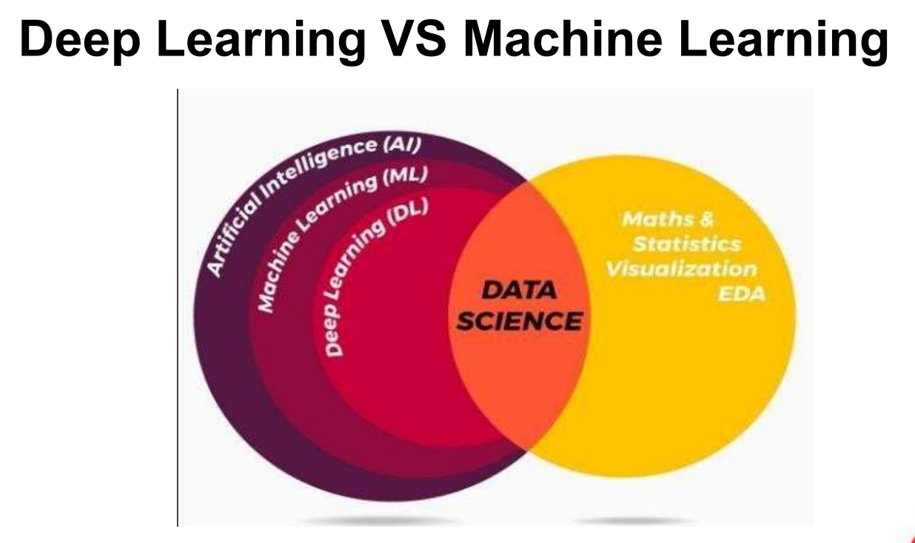
Deep Learning

Slide 2
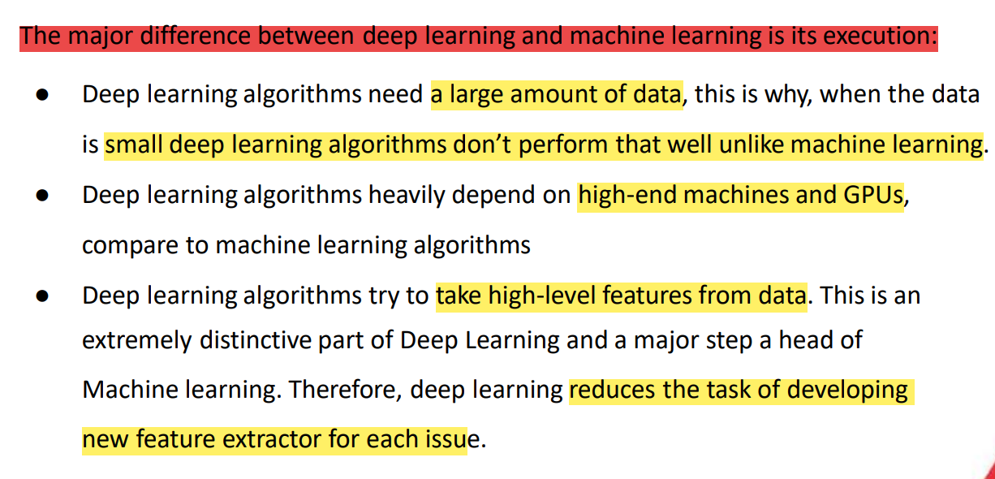
Deep Learning

Slide 3
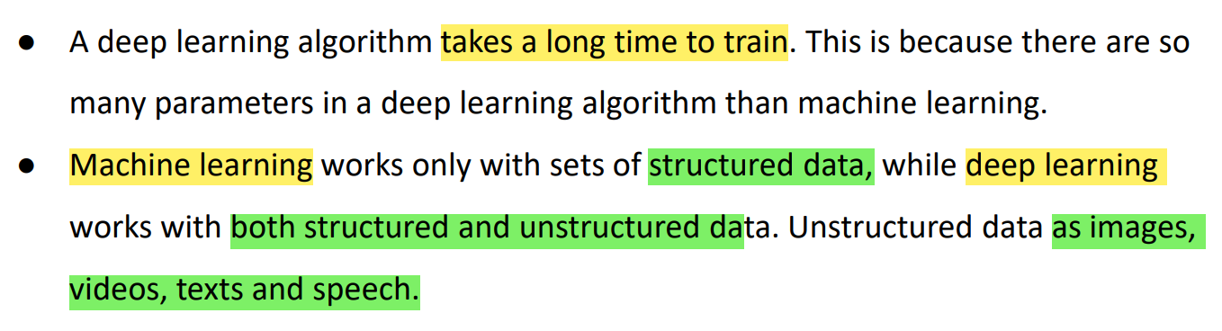
Deep Learning

Slide 4
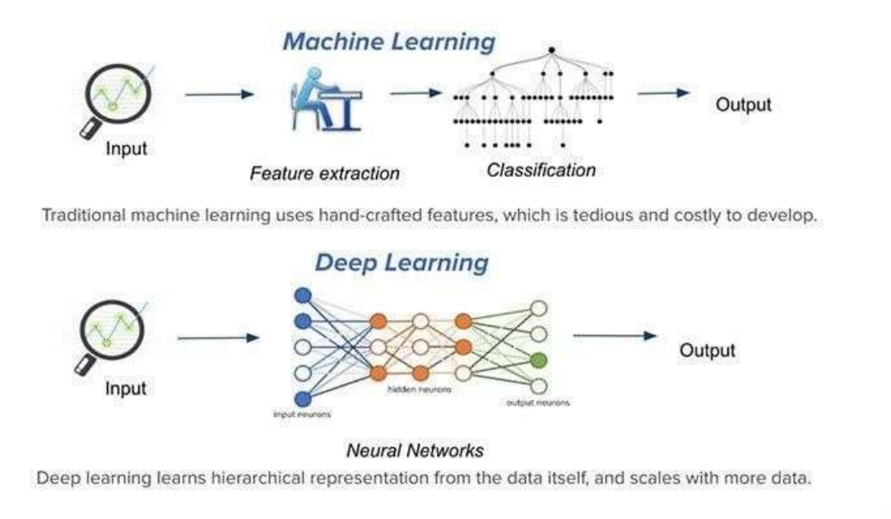
Deep Learning

Slide 5
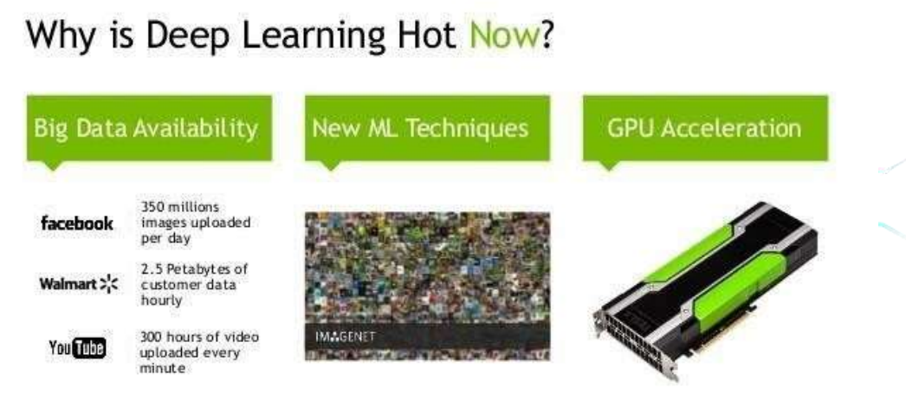
Deep Learning
Deep learning is not entirely new, but it is still a rapidly evolving and emerging field. Here are some key points to understand its status:
Historical Context
Origins: The concepts behind deep learning, such as artificial neural networks, date back to the 1940s and 1950s. Frank Rosenblatt's Perceptron, developed in the 1950s, was one of the earliest models.
Neural Networks: In the 1980s and 1990s, more sophisticated neural network models were developed, but they were limited by the computational power and data availability of the time.

Slide 6
why deep learning is important and how it differs from machine learning:
Key Points from the Image:
Limitations of Machine Learning:
Machine learning plateaus in performance at a certain point.
Adding more data does not necessarily improve the algorithm's performance because it cannot find more correlations to enhance its results.
Advantages of Deep Learning:
Deep learning, which constructs artificial neural networks, improves with the construction of larger neural networks.
Training these larger networks with more data leads to better performance and results.

Slide 7
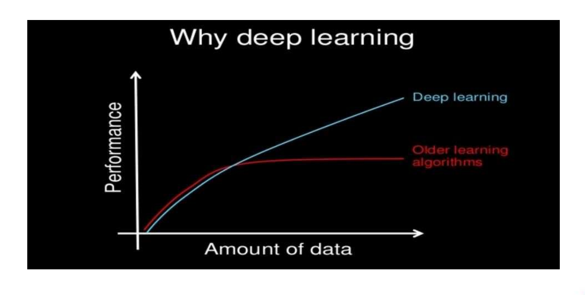

Slide 8
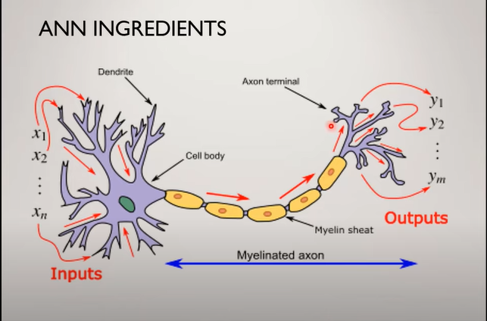
biological

Slide 9
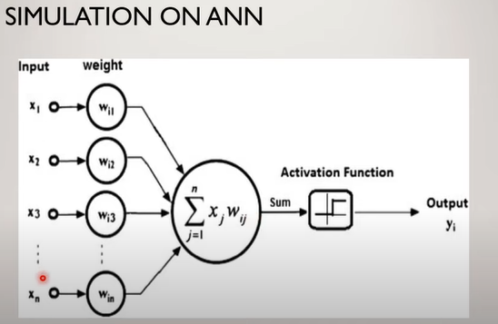

Slide 10
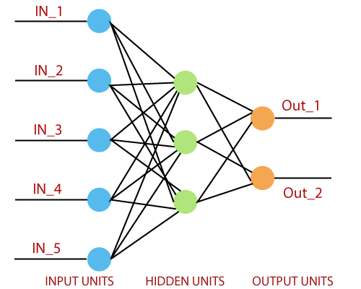
Single layer perceptron

Slide 11
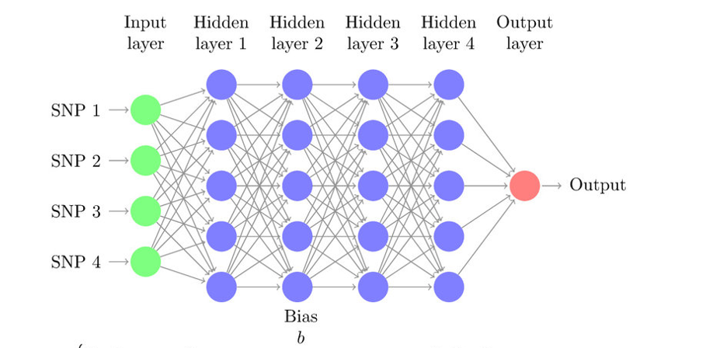
multi-layer perceptron

Slide 12
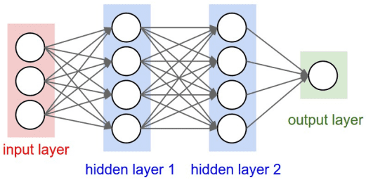
Feedforward Neural network

Slide 13
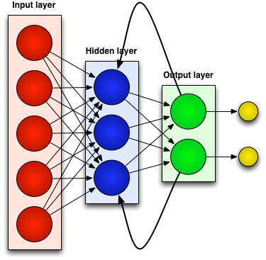
feed backward Neural network

Slide 14
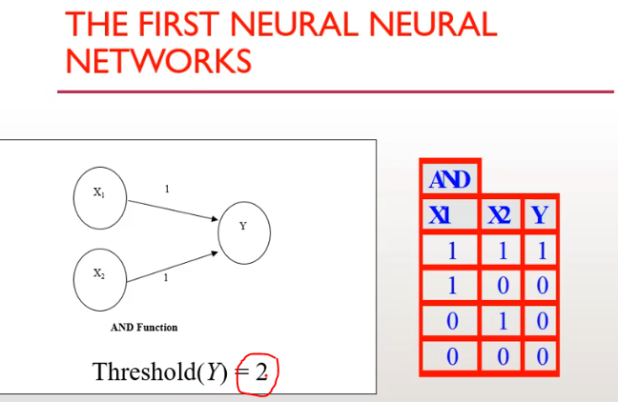

Slide 15
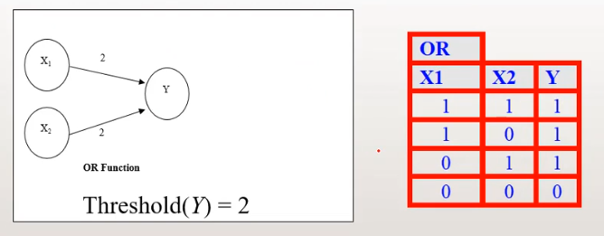

Slide 16
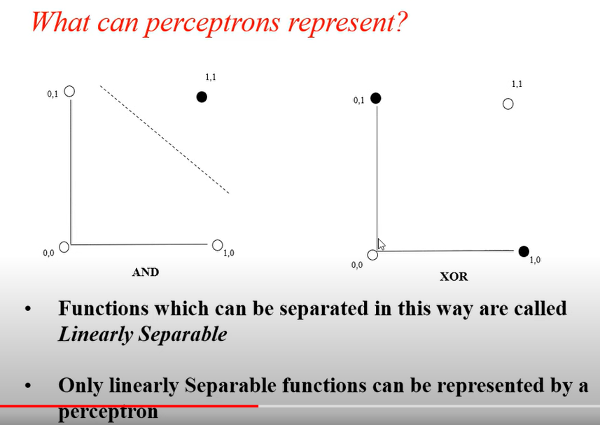

Slide 17
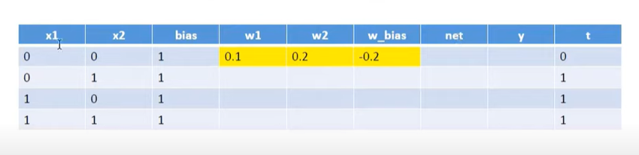
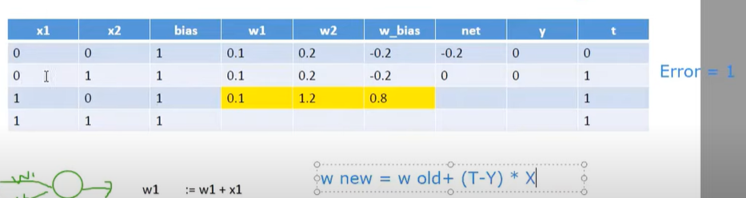
update weight

Slide 18
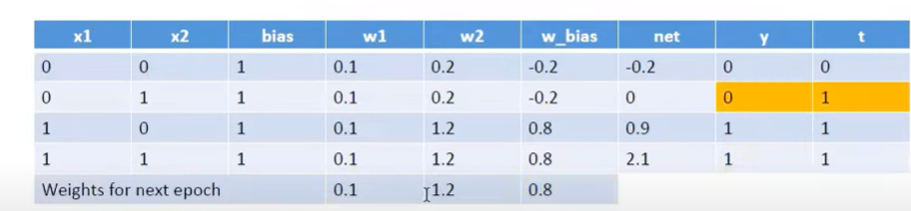
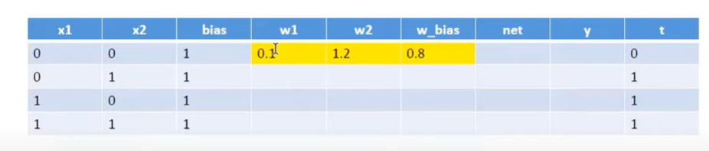

Slide 19
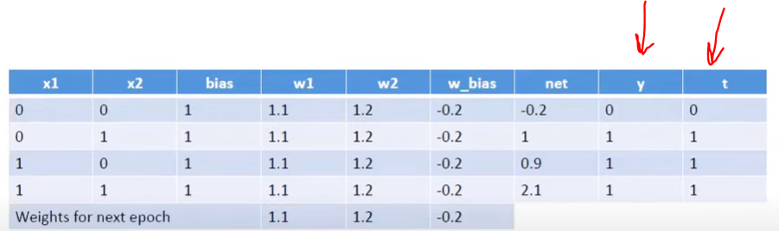

Slide 20
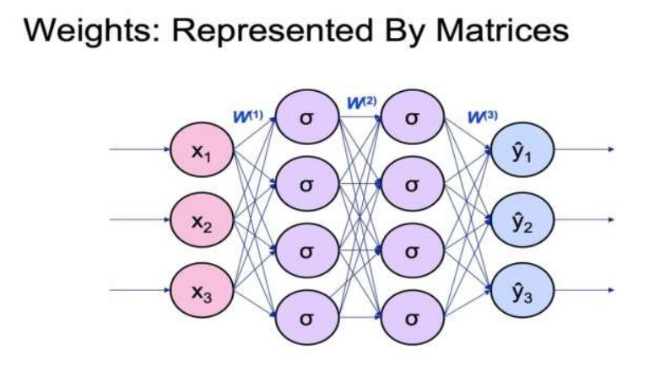
multi-Layer perceptron

Slide 21

Activation Function
- sigmoid function

Slide 22
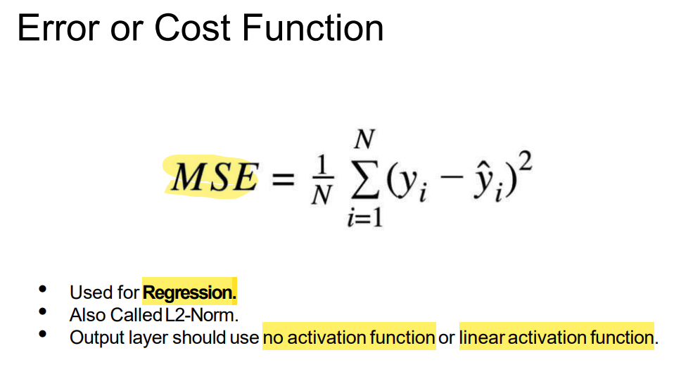
regression

Slide 23
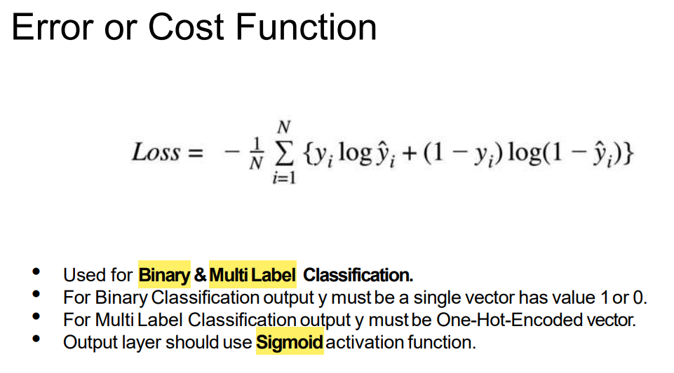
binary classification

Slide 24
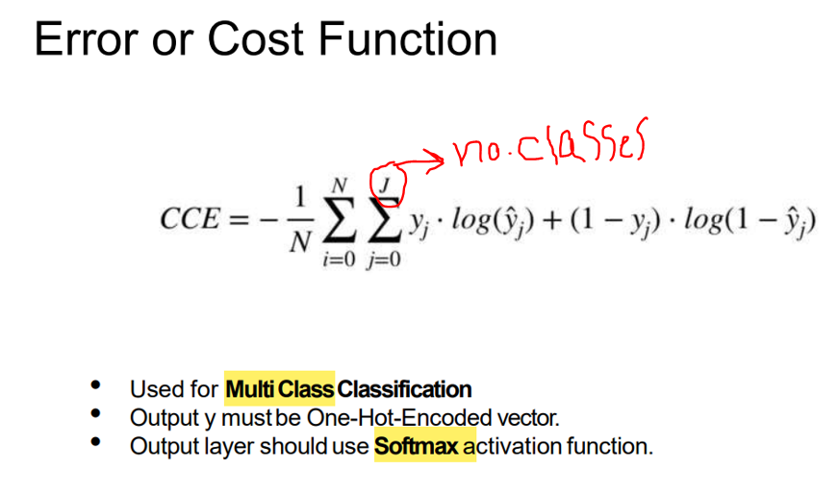
multi classification

Slide 25
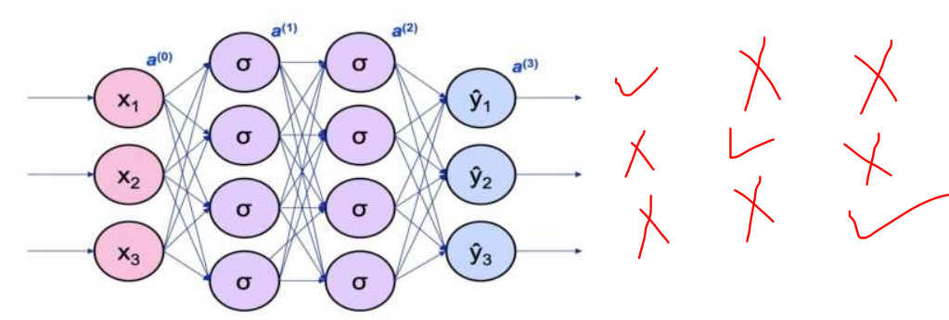
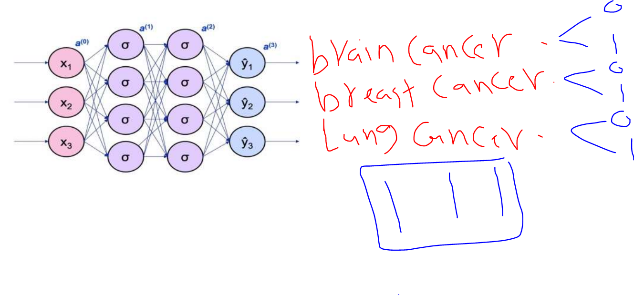
Multi classification vs Multi Label

Slide 26
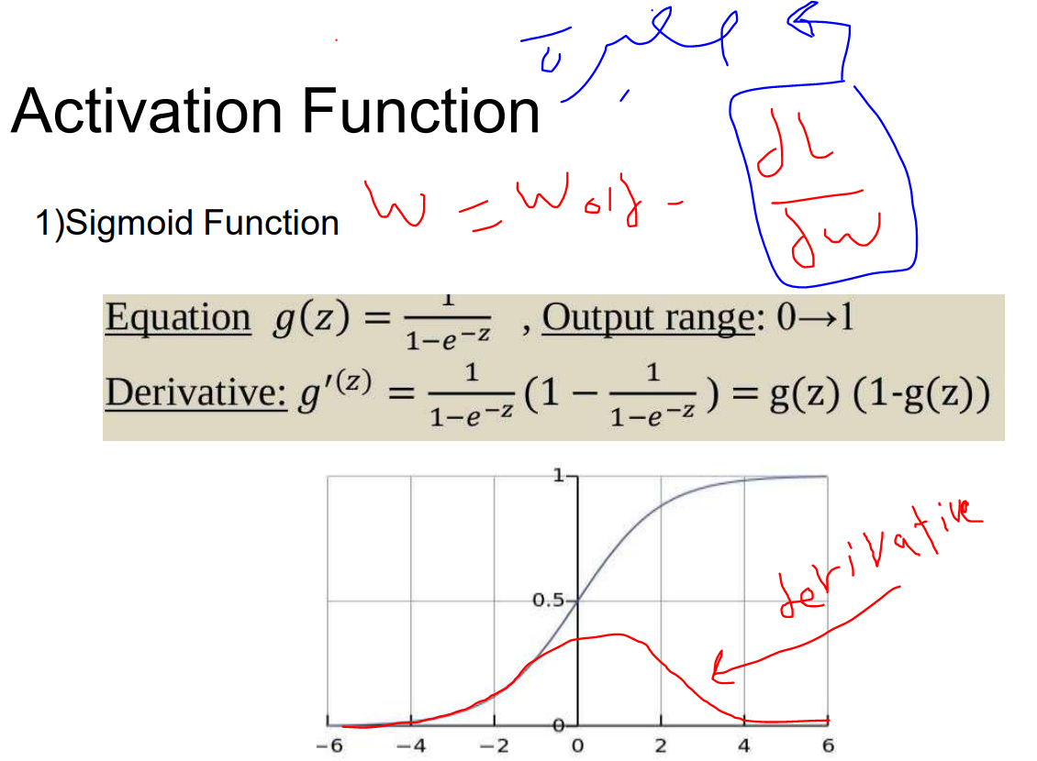

Slide 27
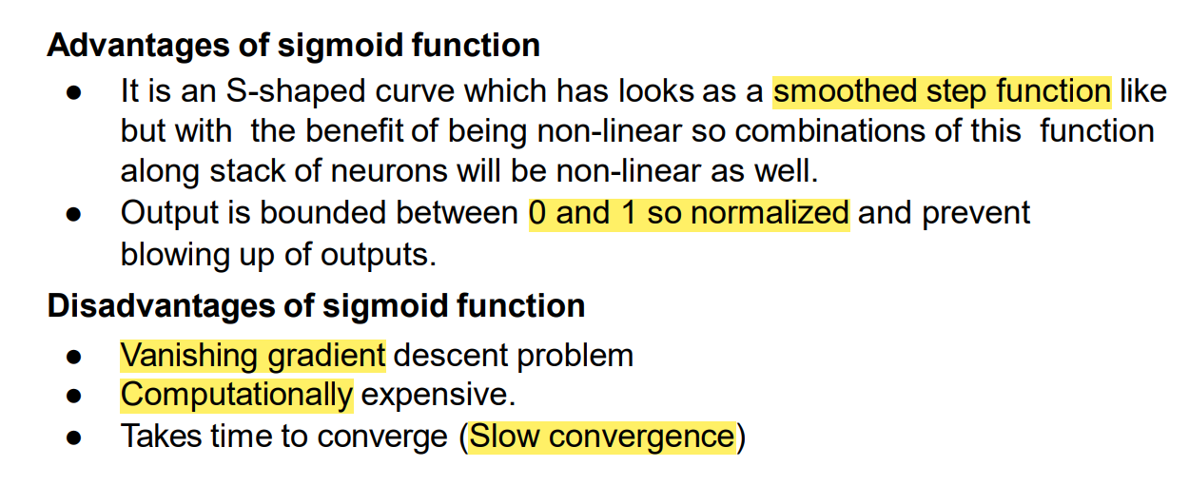

Slide 28
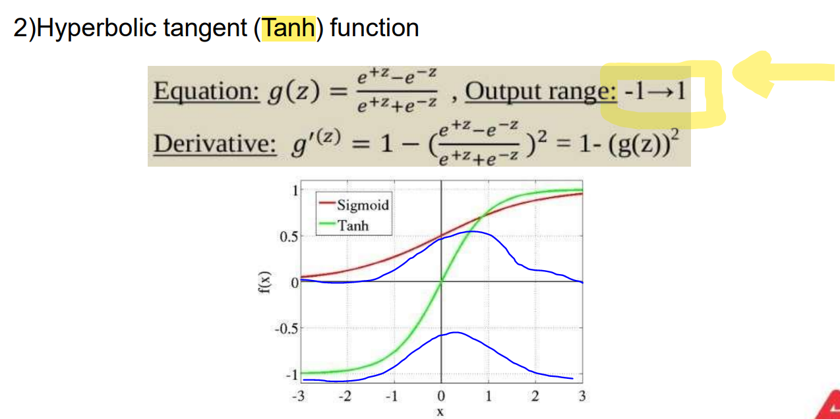

Slide 29
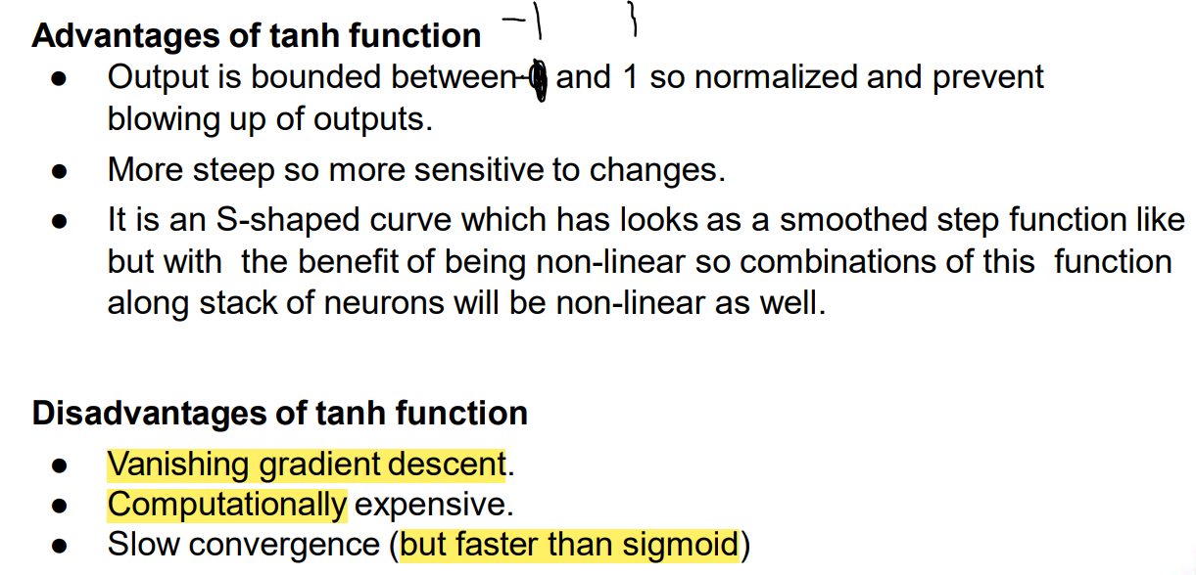

Slide 30
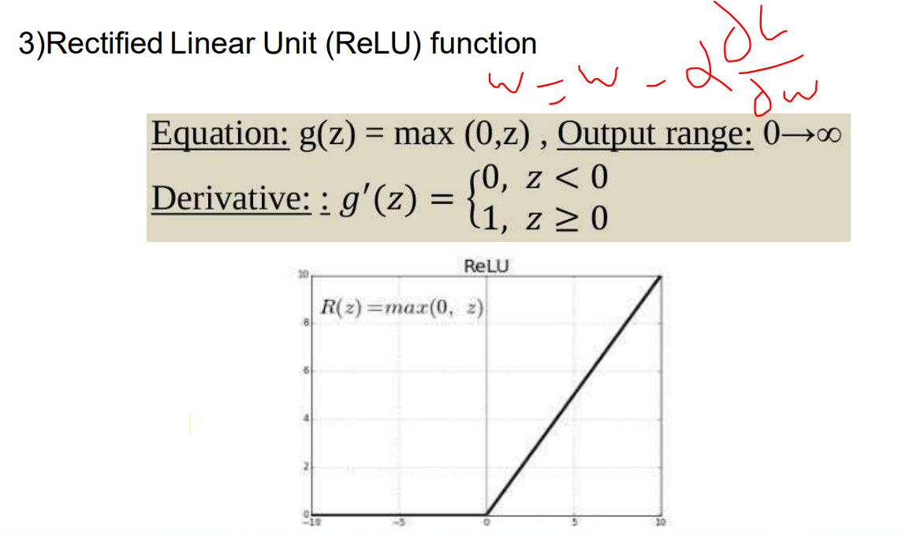

Slide 31
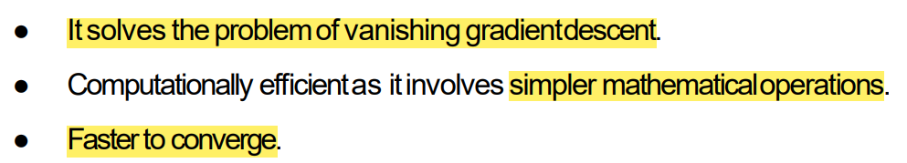
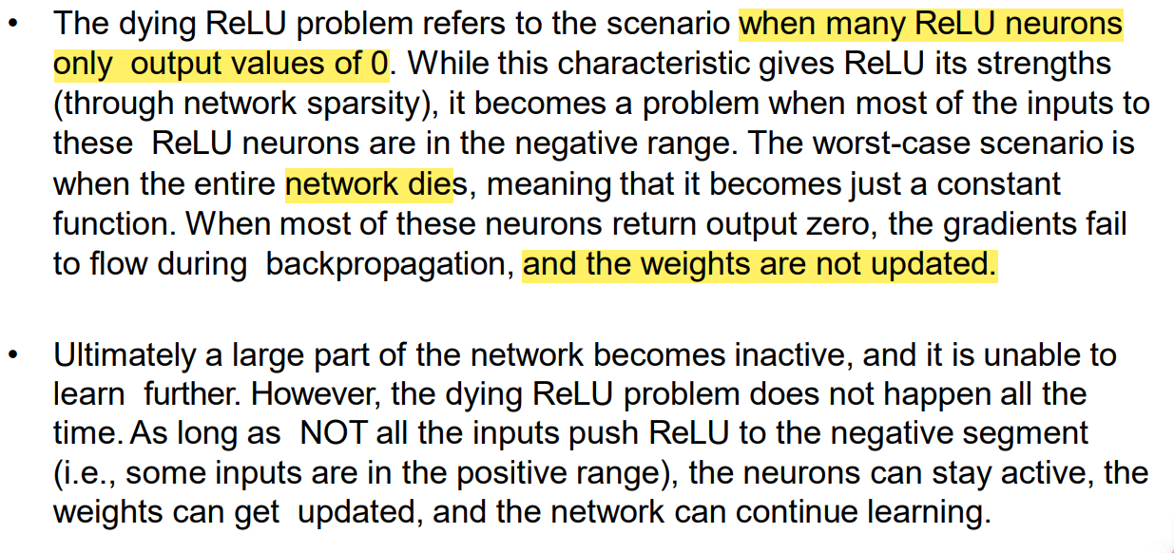

Slide 32
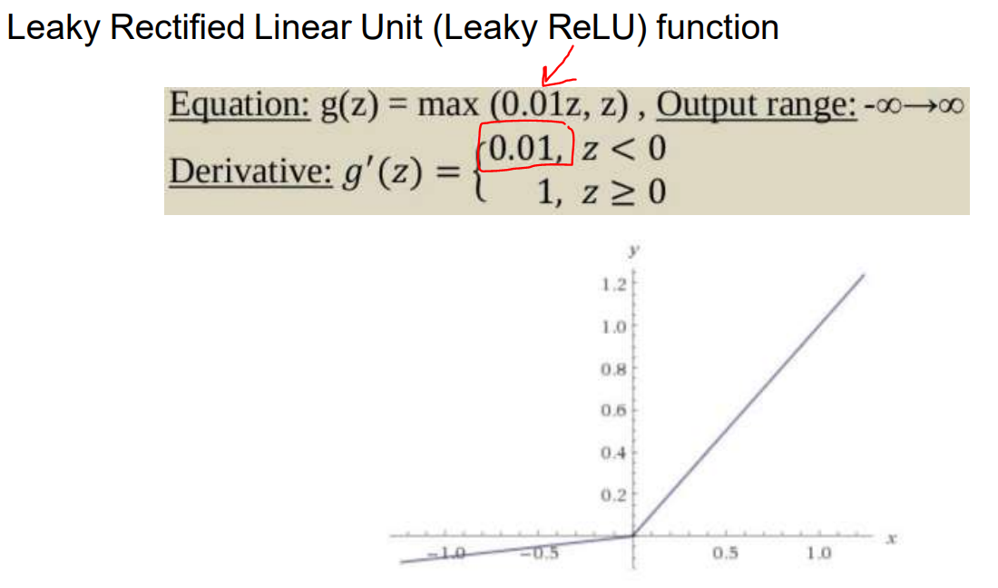

Slide 33
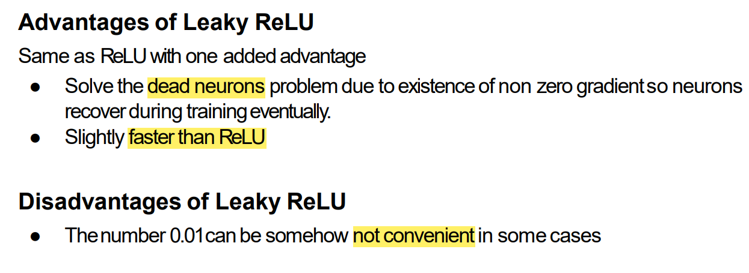

Slide 34
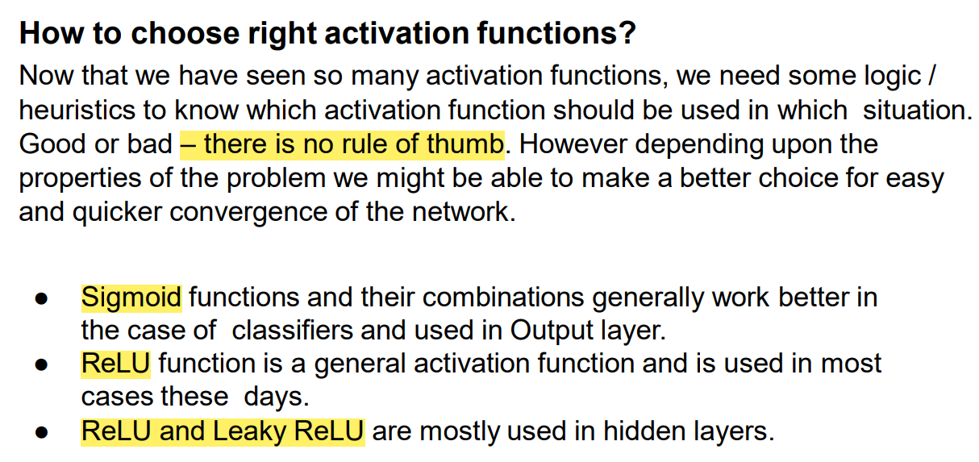

Slide 35

gradient descent

Slide 36
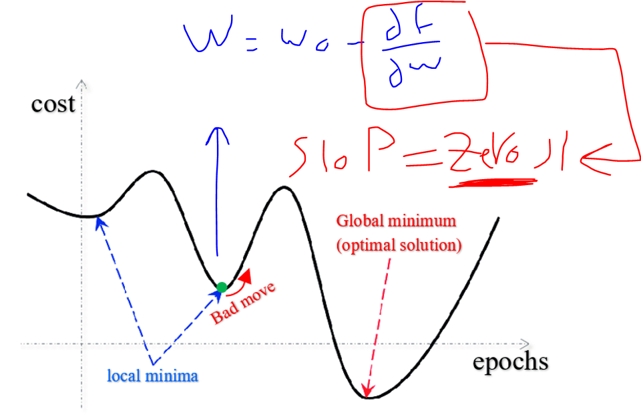
Local and Global Minimum

Slide 37
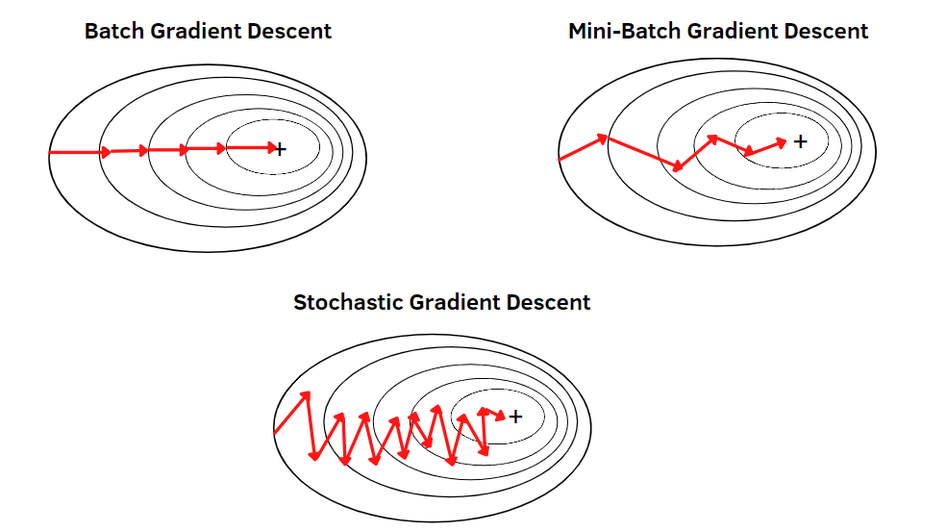
gradient descent

Slide 38
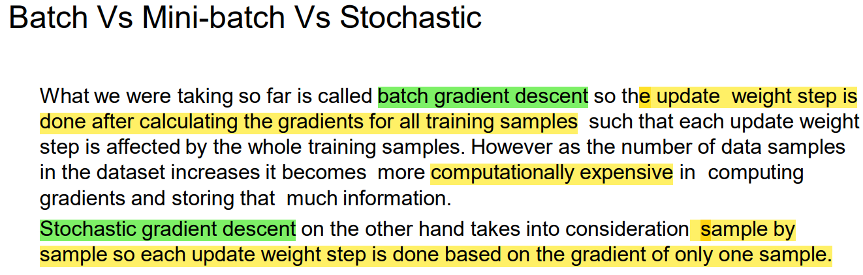
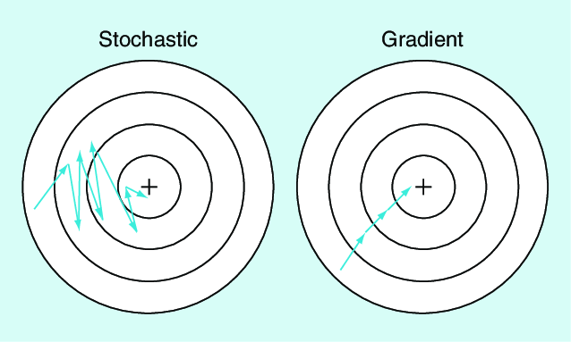

Slide 39
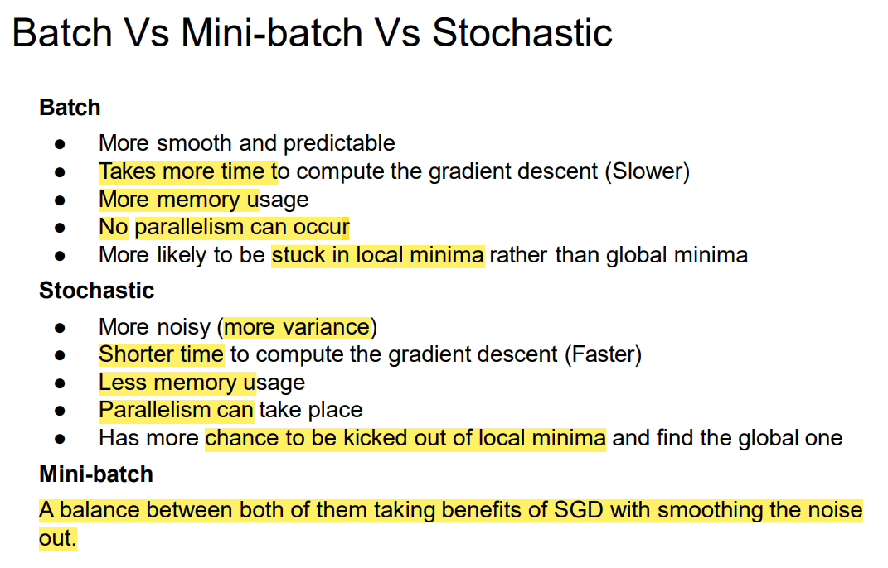

Slide 40
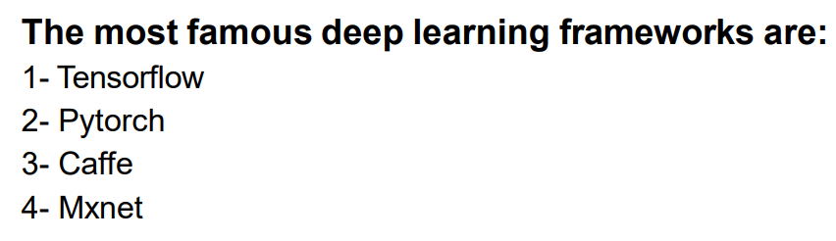
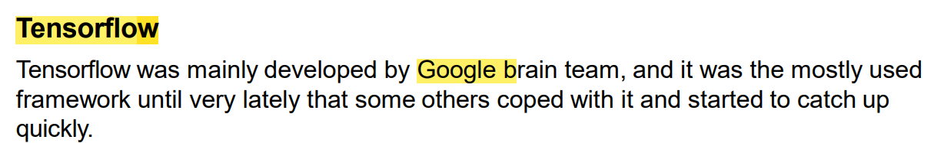
Deep Learning Frameworks

Slide 41
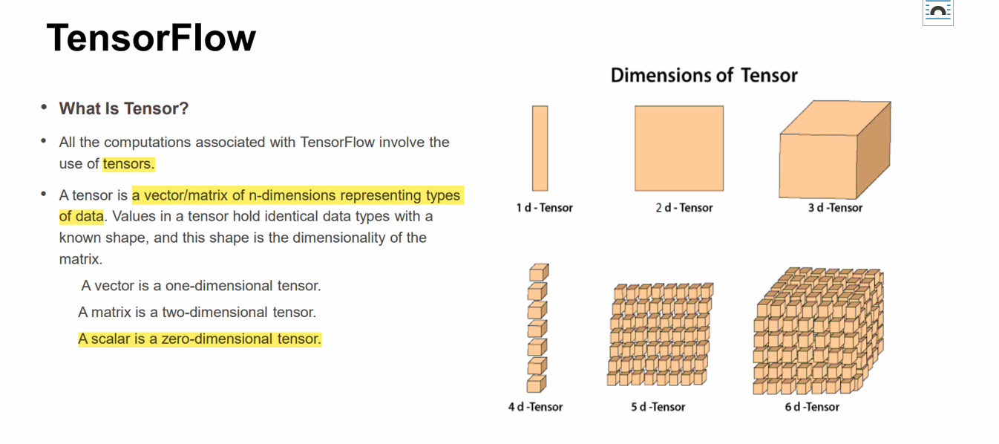

Slide 42
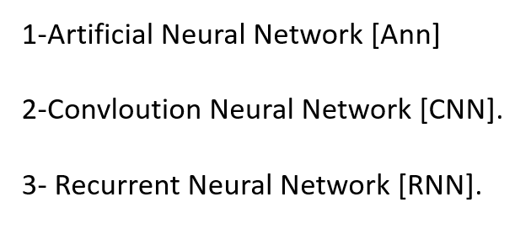
DNN Different Structures:

Slide 43
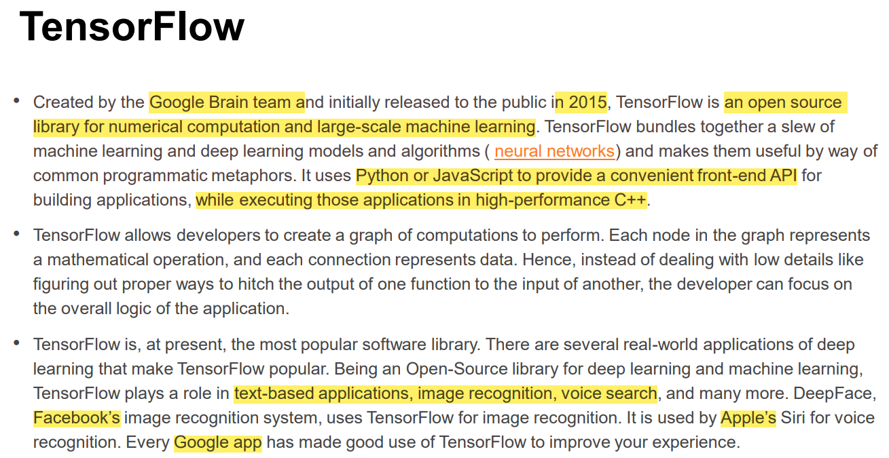

Slide 44
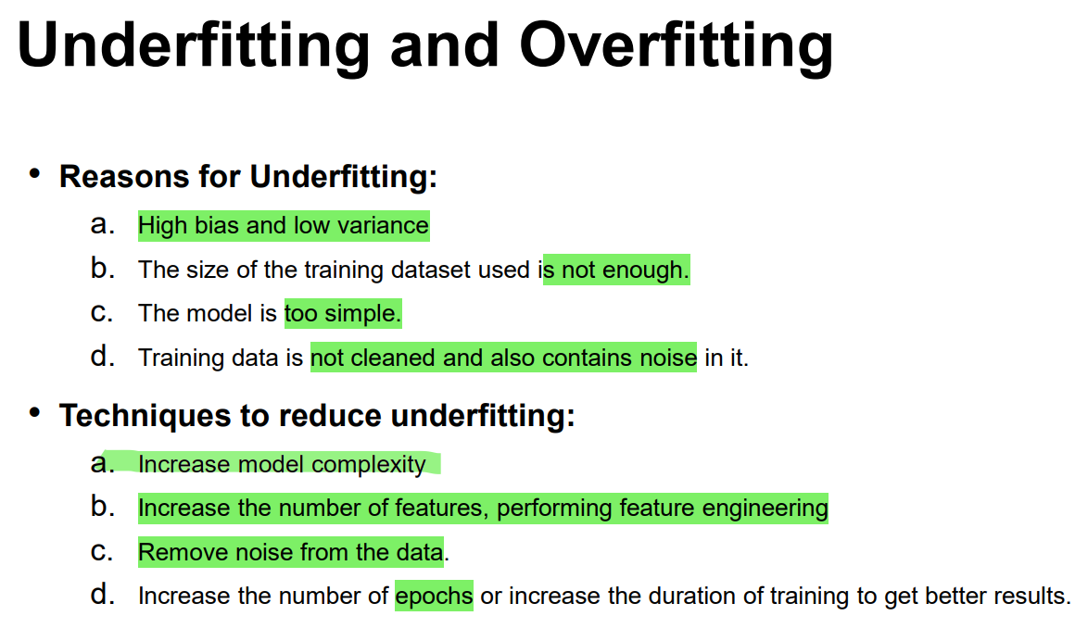

Slide 45
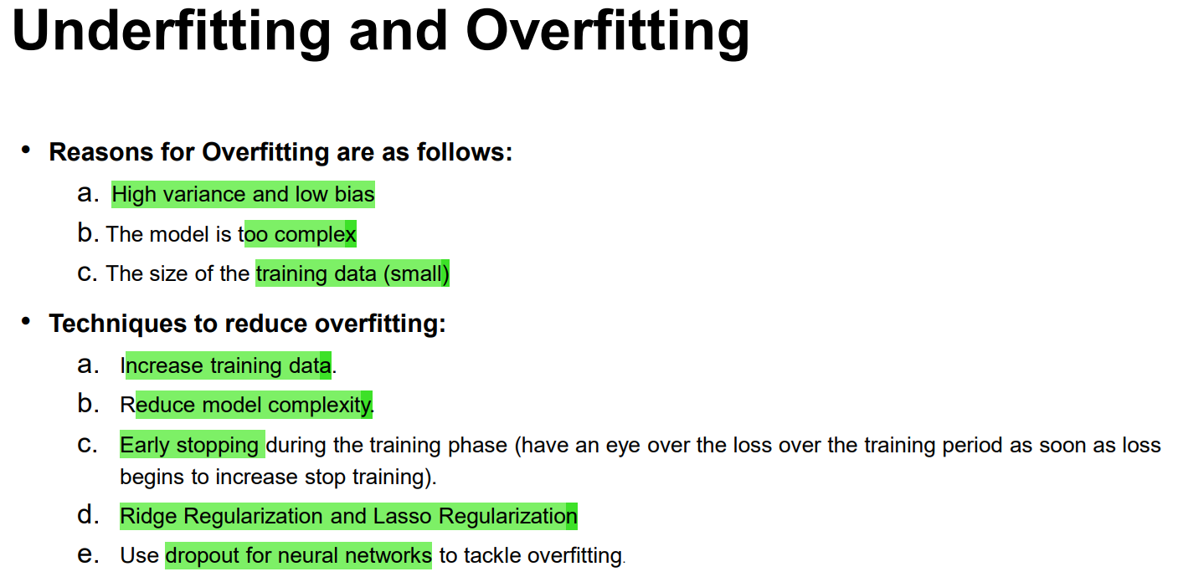

Slide 46
Reduce model complexity
• The first step when dealing with overfitting is to decrease the complexity of the model. To decrease the complexity, we
can simply remove layers or reduce the number of neurons to make the network smaller. While doing this, it is important
to calculate the input and output dimensions of the various layers involved in the neural network. There is no general rule
on how much to remove or how large your network should be. But, if your neural network is overfitting, try making it
smaller.

Slide 47
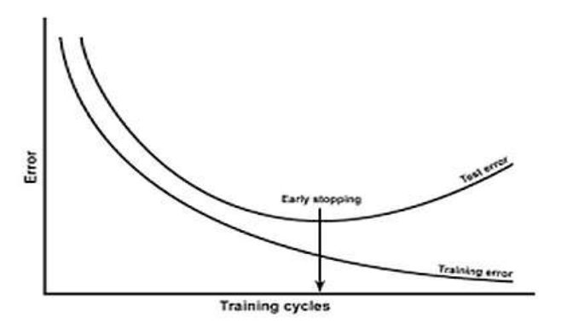
Early Stopping

Slide 48
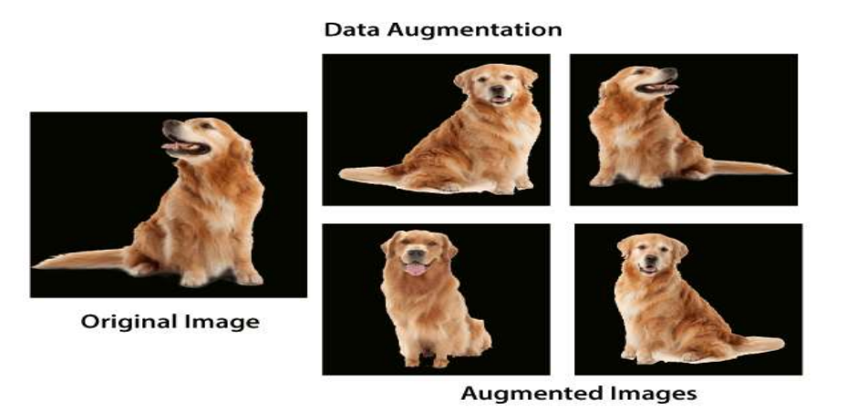
Data Augmentation

Slide 49

Dropouts

Slide 50

Batch Normalization

Slide 51


Batch normalization

Slide 52


Slide 53


Slide 54


Slide 55


Slide 56


Slide 57


Slide 58


Slide 59


Slide 60


Slide 61


Slide 62


